Slide 1
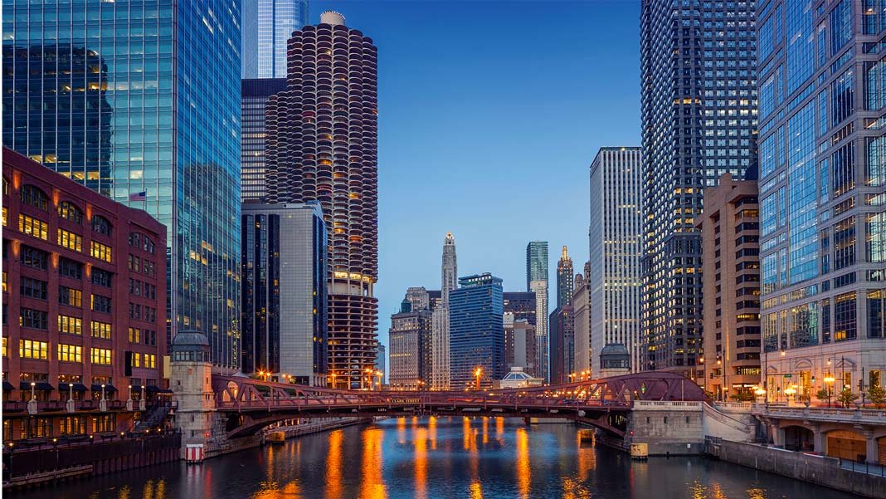
This Photo by Unknown Author is licensed under CC BY-ND

Slide 2
DOWNTOWN HOTEL

Slide 3
KEY DIFFERENTIATOR
*Local Focus: Emphasis on local cuisine, art, and design.
Personalized Service
Intimate atmosphere

Slide 4
TARGET MARKET
BUSINESS TRAVELERS
LEISURE TRAVELERS
RESIDENTS

Slide 5
SERVICES AND AMENITIES
- Rooms: Luxurious, individually designed rooms with modern amenities and local artwork.
- Restaurant: A fine dining restaurant featuring seasonal, locally sourced cuisine. And also
- cozy bar offering a curated selection of local craft beers, wines, and cocktails.
Spa: A small, intimate spa offering a variety of treatments and massages

Slide 6
SERVICES AND AMENITIES
- Fitness center: A well-equipped fitness center with city views.
Concierge services: Personalized local attractions, dining, and events recommendations.

Slide 7
SUPPLIERS
Local artisans and designers: For unique furnishings and decor.
Local food suppliers: For the restaurant and bar.
Cleaning and maintenance services: For housekeeping and general upkeep.
Technology providers: Hotel management systems, Wi-Fi, and other technology.

Slide 8
VISITOR ECONOMIC DATA
According to research from Illinois.gov
122.8 Million hotel visitors: Spending 45.5 billion dollars(2019)
In the 2020 Pandemic the hotel business hit -45% in visitors and – 49% spending.
2023 111.3 Million visitors and 44.3 billion
And Increasing drastically.

Slide 9
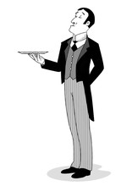
THANK YOU

